Slide 1
Automated Automobile Security
Better Security with Minimal Efforts

Slide 2

Overview An automated enterprise solution for autonomous automobiles. Maximum security with Minimal human input.

Slide 3
The problem
Car hacking remains a very real threat as autos become ever more loaded with tech.
Modern "smart" or internet connected cars most certainly can be subject to car hacking
Vulnerability in a single autonomous device can affect the whole infra.

Slide 4

The logs from vehicle is pushed to Splunk
Log Analysis and Incident Response is done by SOAR
ML to enhance the performance with time
The solution

Slide 5
How it works ?
Logs & Data from Car is pushed to SIEM via forwarders.
SIEM + SOAR identifies malicious activities and minimize the damage in kill chain
Wendy riter
Ronny Reader
Abby Author
Berry Books

Slide 6

The technology Splunk SIEM Phantom CAN Simulator
Splunk IAI

Slide 7
Revenue model
Automobile Companies
Easy Integration with any model
Integration cost will be 1000/car
Scalable
Customer support in Real-Time
AutoSec
Customer/Clients

Slide 8
Automated Automobile Security(AutoSec) Features:
Automobile security
Alerts and Reports at regular intervals
Data Analytics and Visualization
Intelligent Model
Incident Response
March 20XX
July 20XX

Slide 9

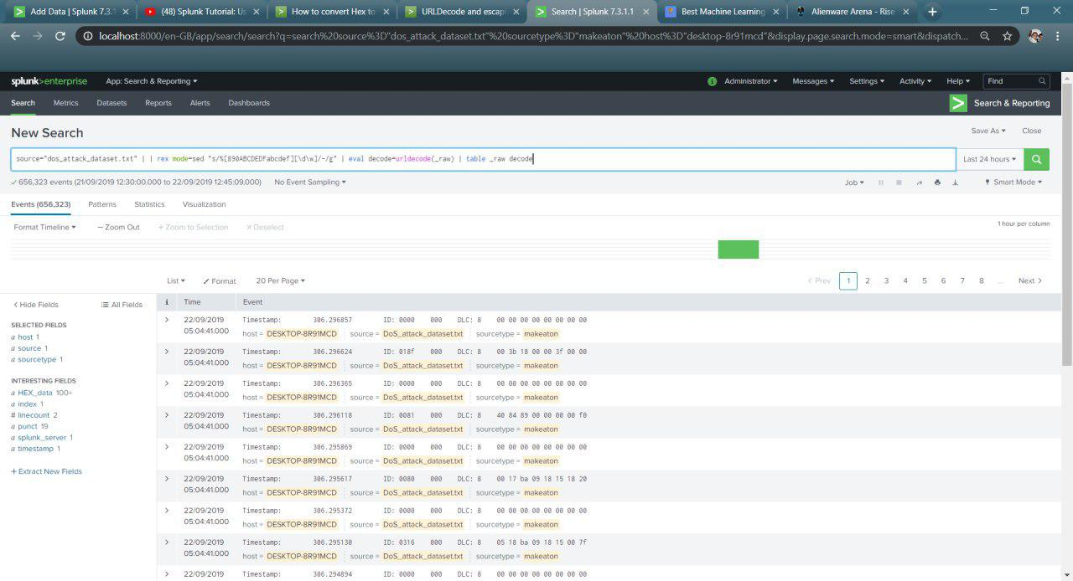
_x0001_
_x0001_

Slide 10
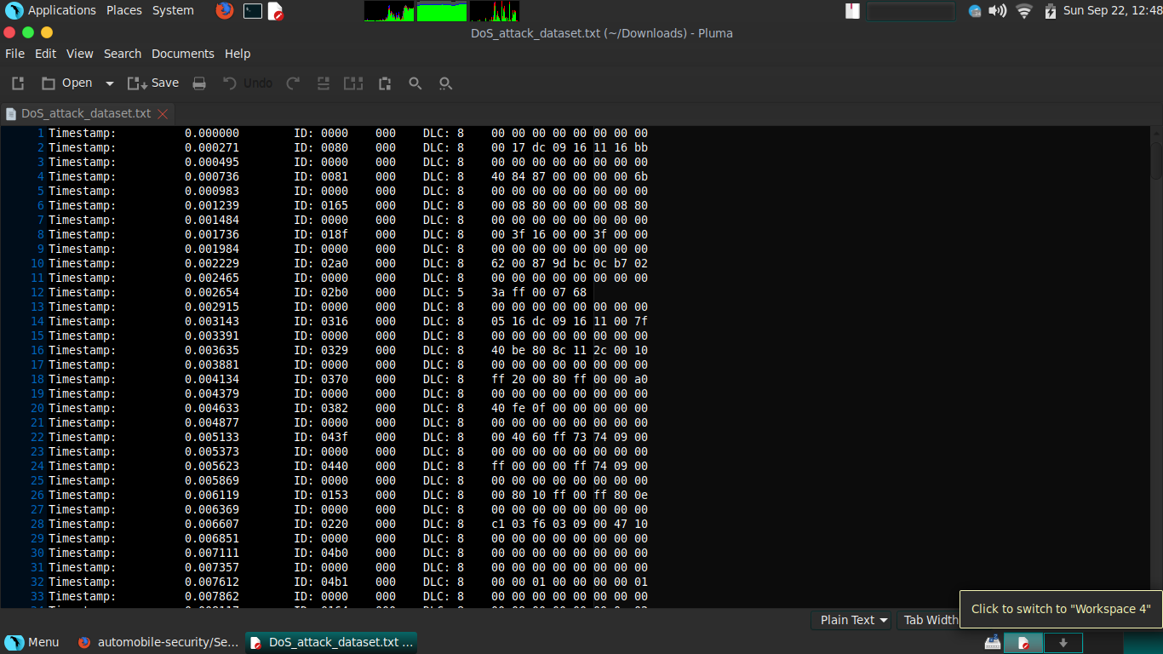

Slide 11
Thank You

